Slide 1
Lecture 9
Use Case Modelling
Inception Phase Requirements Discipline

Slide 2
Agenda
Goals and Scope of a Use Case
Finding Primary Actors, Goals, and Use Cases

Slide 3
How should use cases be discovered?
Which of these is a valid use case?
Negotiate a Supplier Contract
Handle Returns
Log In

Slide 4
EBP
For requirements analysis for a computer application, focus on use cases at the level of elementary business processes (EBPs).
A task performed by one person in one place at one time, in response to a business event, which adds measurable business value and leaves the data in a consistent state. e.g., Approve Credit or Price Order [original source lost].

Slide 5
Use Cases and Goals
And it leads to a recommended procedure:
1. Find the user goals.
2. Define a use case for each.

Slide 6
Finding Primary Actors, Goals, and Use Cases
Choose the system boundary. Is it just a software application, the hardware and application as a unit, that plus a person using it, or an entire organiza tion?
Identify the primary actors.
For each, identify their user goals. Raise them to the highest user goal level that satisfies the EBP guideline.
Define use cases that satisfy user goals; name them according to their goal.

Slide 7
Step 1: Choosing the System Boundary
For this case study, the POS system itself is the system under design;
everything outside of it is outside the system boundary, including the cashier, payment authorization service, and so on.

Slide 8
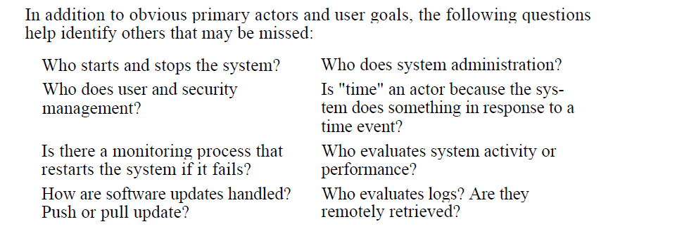
Steps 2 and 3: Finding Primary Actors and Goals

Slide 9
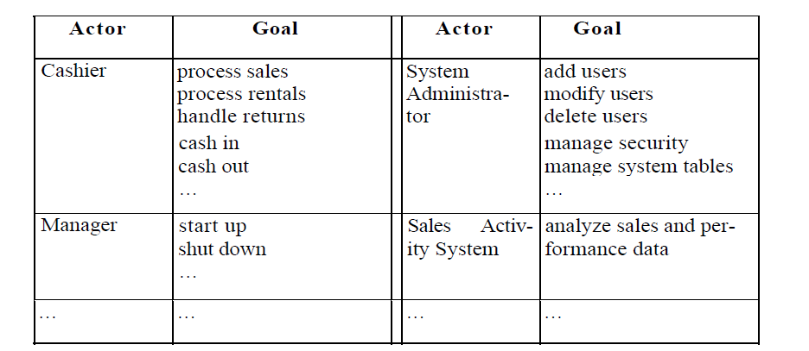

Slide 10
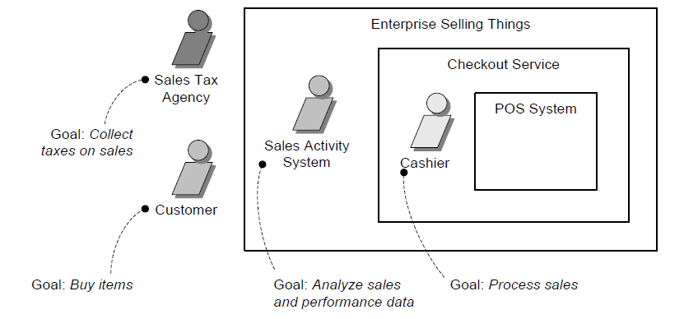
Primary actors and goals at different system boundaries

Slide 11
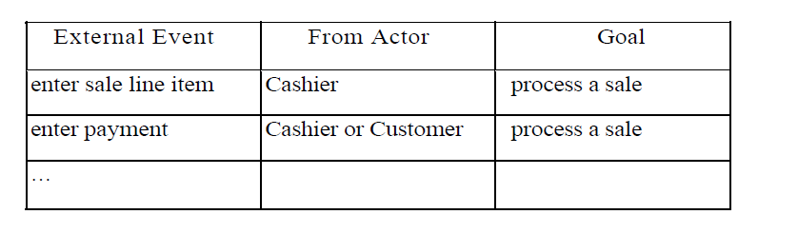
Actors and Goals via Event Analysis

Slide 12
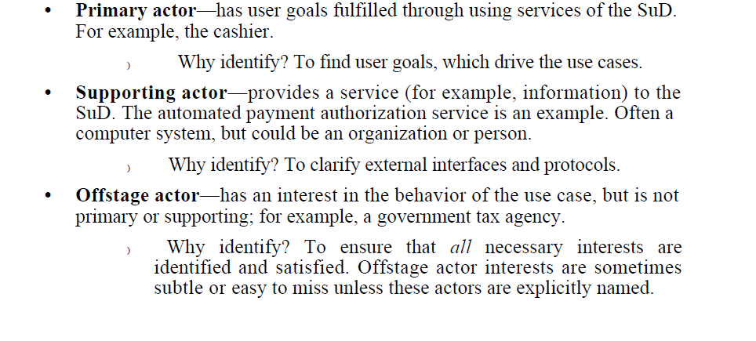
Actors

Slide 13
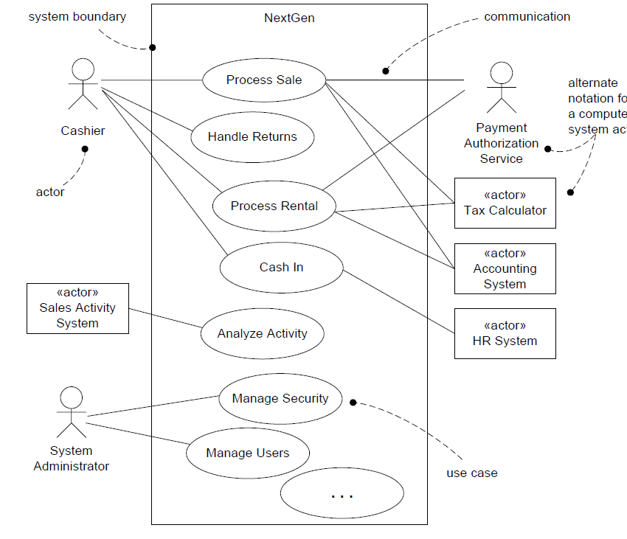

Slide 14
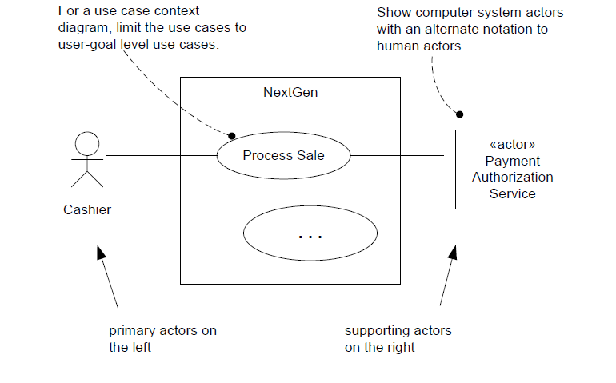
Diagramming Suggestions

Slide 15
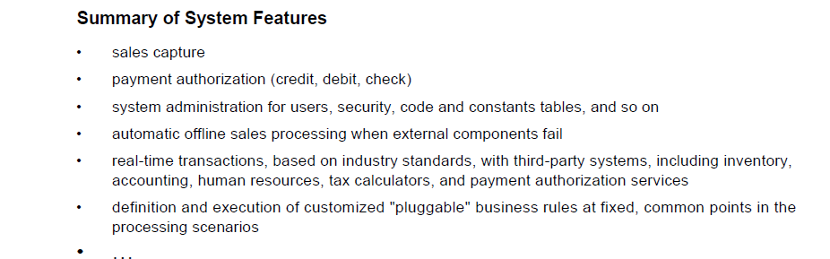
High-Level System Feature Lists Are Acceptable

Slide 16
Use Cases Are Not Object-Oriented
use cases are a broadly applicable requirements analysis tool that can be applied to non-object-oriented projects, which increases their usefulness as a requirements method.
However, as will be explored, use cases are a pivotal input into classic OOA/D activities

Slide 17
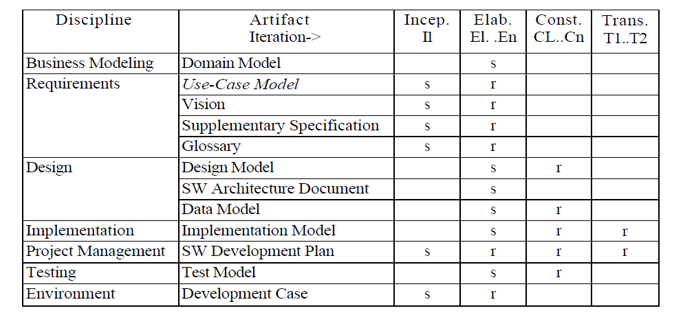

Slide 18
References
Chapter 6 Applying UML and Patterns by Craig Larman

